Slide 1


Slide 2
Denial of Service (DoS)
Denial-of-service (DoS) attack aims at disrupting the authorized use of networks, systems, or applications
  by sending messages which exhaust service provider’s resources (network bandwidth, system resources, application resources)
Distributed denial-of-service (DDoS) attacks employ multiple (dozens to millions) compromised computers to perform a coordinated and widely distributed DoS attack
Victims of (D)DoS attacks
  service-providers (in terms of time, money, resources, good will)
  legitimate service-seekers (deprived of availability of service itself)
  Zombie systems

Slide 3
History of Denial of Service Attacks
Early 1990s: Individual Attacks. First DoS Tools
Late 1990s: Botnets, First DDoS Tools
Feb 2000: First Large-Scale DDoS Attack
  CNN, Yahoo, E*Trade, eBay, Amazon.com, Buy.com
2007: DDoS against Estonia
2008: DDoS against political groups
2008: DDoS against Republic of Georgia during military conflict with Russia
Notes:
Here is a brief history of Denial of Service attacks. They started out as single attacks perpetrated from one user against another user, using applications that allowed the user to kick off an attack at the click of a button. Then in the late 90s the first botnets were formed and Distributed Denial of Service tools were created. In 2000, the first highly publicized DDoS attack was committed against several large companies who had a significant Internet presence. Then in 2004, online criminals began offering DDoS for hire and using the threat of DDoS attack for extortion. Most recently, in 2007 and 2008, Distributed Denial of Service attacks have been used for political purposes, and even in coordination with military operations.

Slide 4
Types of DoS Attacks
Network / Transport Layer Attacks
  TCP SYN Flood Attack
  Smurf IP Attack
  UDP Flood Attack (Echo/Chargen)
  Ping of Death
Application Layer Attacks
  No known pre-packaged attacks
Can be performed individually, but gain power when used by a DDoS botnet
Notes:
There are several types of Denial of Service attacks. These attacks can be carried out by a single attacker, or used by a botnet to carry out a distributed attack. There are two main types of attacks, those that occur at the Network and Transport Layers, and a newer kind that occurs at the Application Layer. Network and Transport layer attacks work at the packet level and can affect servers as well as networking equipment. Application Layer attacks work against a specific application, such as a web server, VOIP, Instant Messenger, or streaming media.

Slide 5
Contents
Introduction
Classical DoS attacks
Flooding attacks
Distributed Denial-of-Service (DDoS)
Reflector and amplifier attacks
Other DoS attacks
Approaches to defense against DoS

Slide 6
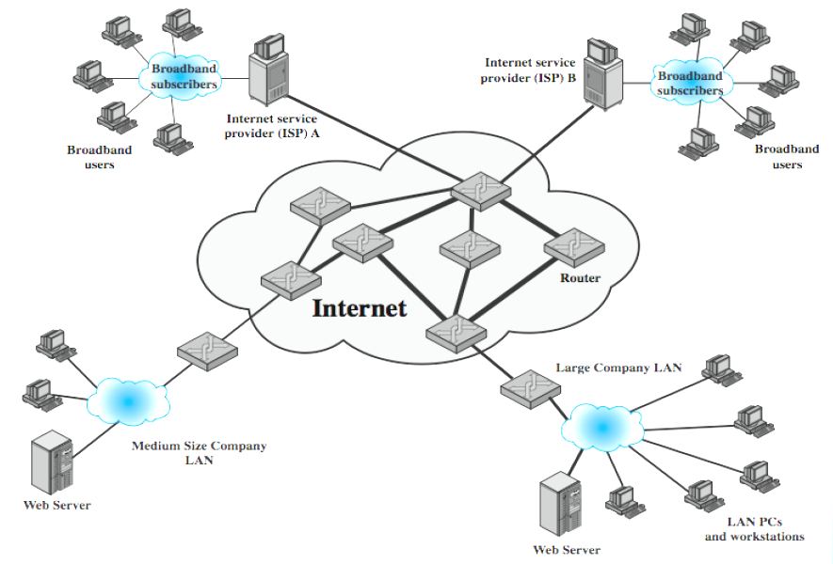
Classical DoS attacks
Simplest classical DoS attack: Flooding attack on an organization
  Ping flood attack
Service denied to legitimate users

Slide 7
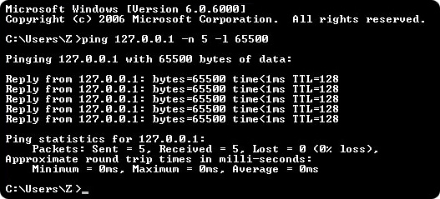
Ping flood attack
Use of ping command options -n –l
Ping of Death
Source: learn-networking.com

Slide 8
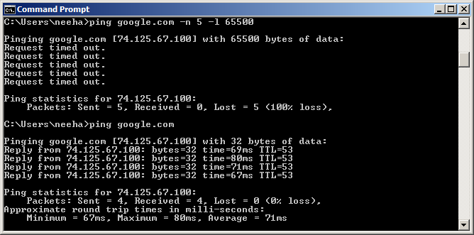
Ping flood attack cont’d ….
Generally useless on larger networks or websites

Slide 9
Disadvantage to attacker
Attacker’s source is easily identified
Chances of attack flow being reflected back to attacker

Slide 10
SYN spoofing / TCP SYN Flood Attack
Takes advantage of the three-way handshake that occurs any time two systems across the network initiate a TCP connection request
Unlike usual brute-force attack, not done by exhausting network resources but done by overflowing the system resources (tables used to manage TCP connections)
Consequence: Failure of future connection requests ,thereby denying access to the server for legitimate users
Example: land.c sends TCP SYN packet using target’s address as source as well as destination

Slide 11
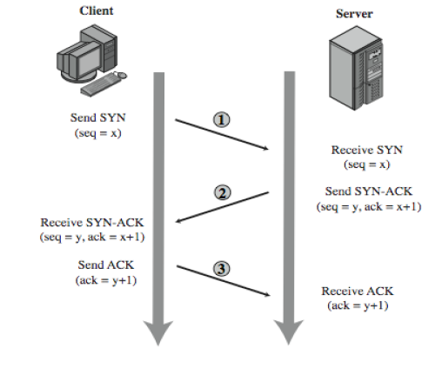
TCP 3-way connection handshake
Address,
Port number,
Seq x
Recorded in a table of known TCP connections
Server in LISTEN State
Vulnerability: Unbounded ness of LISTEN state

Slide 12
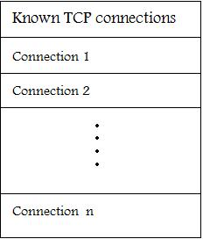
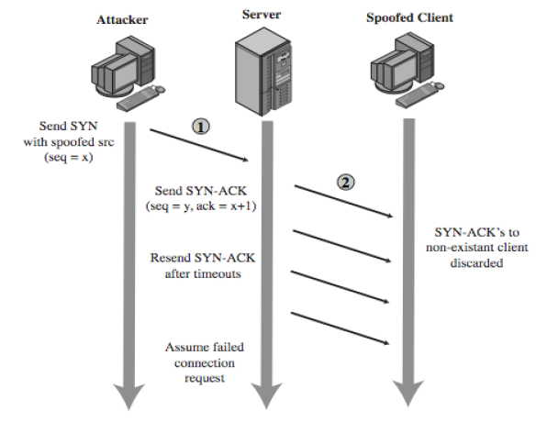
SYN spoofing cont’d ….

Slide 13
Factors considered by attacker for SYN spoofing
The number of sent forged packets are just large enough to exhaust the table but small as compared to a typical flooding attack
Keep sufficient volume of forged requests flowing
Using a wide range of random addresses
  A collection of compromised hosts under the attacker's control (i.e., a "botnet") could be used

Slide 14
Detecting SYN spoof attack
After the target system has tried to send a SYN/ACK packet to the client and while it is waiting to receive an ACK packet, the existing connection is said to be half open or host in SYN_RECEIVED state
If your system is in this state, it may be experiencing SYN-spoof attack
To determine whether connections on your system are half open, type netstat –a command
This command gives a set of active connections. Check for those in the state SYN_RECEIVED which is an indication of the threat of SYN spoof attack

Slide 15
Contents
Introduction
Classical DoS attacks
Flooding attacks
Distributed Denial-of-Service (DDoS)
Reflector and amplifier attacks
Other DoS attacks
Approaches to defense against DoS

Slide 16
Flooding attacks
Goal : Bombarding large number of malicious packets at the victim, such that processing of these packets consumes resources
Any type of network packet can be used
  Attack traffic made similar to legitimate traffic
Valid traffic has a low probability of surviving the discard caused by flood and hence accessing the server
Some ways of flooding :
  To overload network capacity on some link to a server
  To overload server’s ability to handle and respond to this traffic
The larger the packet, the more effective the attack

Slide 17
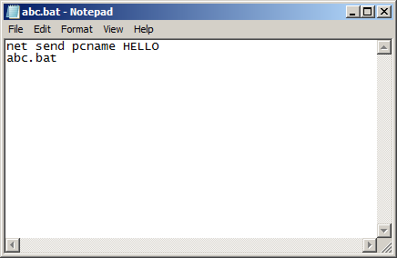
Flooding attack within local network
Simply sending infinite messages from one computer to another on the local network , thereby wasting the resources of the recipient computer to receive and tackle the messages
The following code (abc.bat) sends infinite messages to victim

Slide 18
Types of flooding attacks
Classified based on type of network protocol used to attack
ICMP flood
  Uses ICMP packets , ex: ping flood using echo request
  Typically allowed through, some required
UDP flood
  Exploits the target system’s diagnostic echo services to create an infinite loop between two or more UDP services
TCP SYN flood
  Use TCP SYN (connection request packets)
  But for volume packet

Slide 19
Indirect attacks
Single-sourced attacker would be traced
Scaling would be difficult
Instead use multiple and distributed sources
  None of them generates traffic to bring down its own local network
  The Internet delivers all attack traffic to the victim
Thus, victims service is denied while the attackers are still fully operational
Indirect attack types
  Distributed DoS
  Reflected and amplifier attacks

Slide 20
Contents
Introduction
Classical DoS attacks
Flooding attacks
Distributed Denial-of-Service (DDoS)
Reflector and amplifier attacks
Other DoS attacks
Approaches to defense against DoS

Slide 21
Distributed Denial-of-service
Attacker uses multiple compromised user work stations/PCs for DoS by:
  Utilising vulnerabilities to gain access to these systems
  Installing malicious backdoor programs , thereby making zombies
  Creating botnets: large collection of zombies under the control of attacker
Generally, a control hierarchy is used to create botnets
  Handlers: The initial layer of zombies that are directly controlled by the attacker
  Agent systems: Subordinate zombies that are controlled by handlers
  Attacker sends a single command to handler, which then automatically forwards it to all agents under its control
Example: Tribe Flood Network (TFN), TFN2K

Slide 22
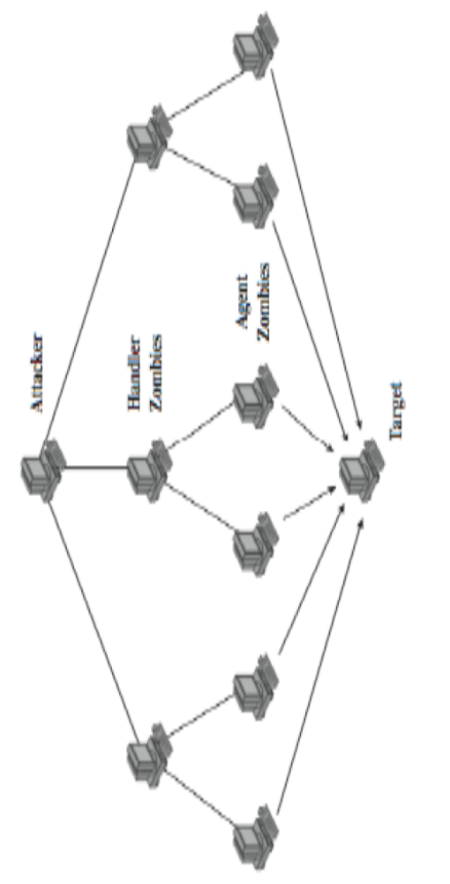
DDoS control hierarchy
Example: Tribe Flood Network (TFN)
  Relied on large number of compromised systems and layered command structure

Slide 23
Contents
Introduction
Classical DoS attacks
Flooding attacks
Distributed Denial-of-Service (DDoS)
Reflector and amplifier attacks
Other DoS attacks
Approaches to defense against DoS

Slide 24
Reflector and amplifier attacks
Unlike DDoS attacks, the intermediaries are not compromised
R & A attacks use network systems functioning normally
Generic process:
  A network packet with a spoofed source address is sent to a service running on some network server
  A response to this packet is sent to the spoofed address (victim) by server
  A number of such requests spoofed with same address are sent to various servers
  A large flood of responses overwhelm the target’s network link
Spoofing utilized for reflecting traffic
These attacks are easier to deploy and harder to trace back

Slide 25
Reflection attacks
Direct implementation of the generic process explained before
  Reflector : Intermediary where the attack is reflected
  Make sure the packet flow is similar to legitimate flow
Attacker’s preference: response packet size > original request size
Various protocols satisfying this condition are preferred
  chargen, DNS, etc

Slide 26
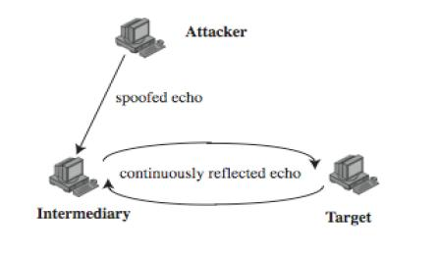
Large UDP Packet+
spoofed source

Slide 27
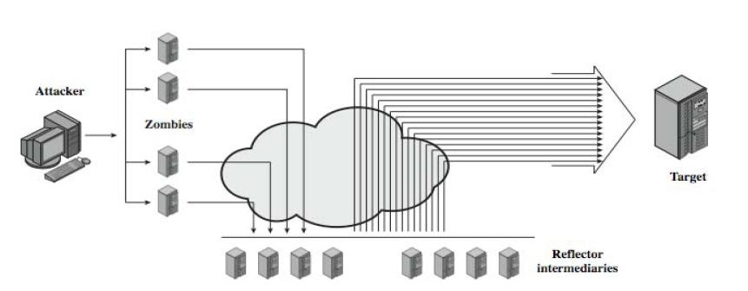
Amplification attacks
Differ in intermediaries generate multiple response packets for each original packet sent

Slide 28
Amplification attacks possibilities
Utilize service handled by large number of hosts on intermediate network
A ping flood using ICMP echo request packets
  Ex: smurf DoS program

Slide 29
Smurf DoS program
Two main components
  Send source-forged ICMP echo packet requests from remote locations
  Packets directed to IP broadcast addresses
If the intermediary does not filter this broadcast traffic, many of the machines on the network would receive and respond to these spoofed packets
  When entire network responds, successful smurf DoS has been performed on the target network
Besides victim network, intermediary network might also suffer
  Smurf DoS attack with single/multiple intermediary(s)
  Analyze network routers that do not filter broadcast traffic
  Look for networks where multiple hosts respond

Slide 30
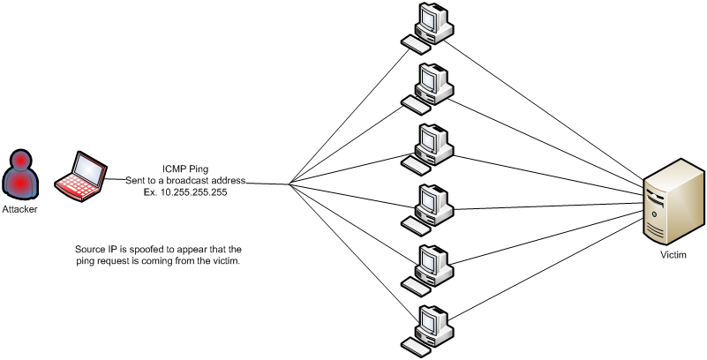
Smurf IP Attack
Notes:
The Smurf IP Attack is named after an application that lets the attacker carry out the attack. In a Smurf IP attack, the attacker sends a ping request to the broadcast address, modifying the packet to have the victim’s IP address as the source. Because the ping was sent to a broadcast address, it was received by all other computers on the subnet. They read the source IP address, belonging to the victim, and all of them send replies to the victim, overwhelming it with replies.

Slide 31
UDP Flood Attack (Echo/Chargen)
Flood the victim with continuous stream of UDP packets
Well known exploit Echo/Chargen
  Chargen – writes continuous stream of characters to a network output (originally used for testing purposes)
  Echo – reads from the network and “echoes” back what it has read
  Attacker can pipe output from chargen to echo and cause a never ending stream of network activity.
Notes:
Another type of Denial of Service attack at the transport layer is the UDP Flood attack, where the attacker fires UDP packets at the victim, attempting to overload a service that is listening for UDP packets.

Slide 32
DNS amplification attacks
DNS servers is the intermediary system
Exploit DNS behavior to convert a small request to a much larger response
  60 byte request to 512 – 4000 byte response
Sending DNS requests with spoofed source address being the target to the chosen servers
Attacker sends requests to multiple well connected servers, which flood target
  Moderate flow of packets from attacker is sufficient
  Target overwhelmed with amplified responses from server

Slide 33
Contents
Introduction
Classical DoS attacks
Flooding attacks
Distributed Denial-of-Service (DDoS)
Reflector and amplifier attacks
Other DoS attacks
Detecting DoS attacks
Approaches to defense against DoS

Slide 34
Teardrop
This DoS attack affects Windows 3.1, 95 and NT machines and Linux versions previous to 2.0.32 and 2.1.63
Teardrop is a program that sends IP fragments to a machine connected to the Internet or a network
Teardrop exploits an overlapping IP fragment bug
  The bug causes the TCP/IP fragmentation re-assembly code to improperly handle overlapping IP fragments
  A 4000 bytes of data is sent as
    Legitimately (Bytes 1-1500) (Bytes 1501 – 3000) (Bytes 3001-4500)
    Overlapping (Bytes 1-1500) (Bytes 1501 – 3000) (Bytes 1001-3600)
This attack has not been shown to cause any significant damage to systems
The primary problem with this is loss of data

Slide 35
Cyberslam
DDoS attack in a different style
Zombies DO NOT launch a SYN Flood or issue dummy packets that will congest the Web server’s access link
Zombies fetch files or query search engine databases at the Web server
From the web server’s perspective, these zombie requests look exactly like legitimate requests
so the server ends up spending lot of its time serving zombies, causing DoS to legitimate users

Slide 36
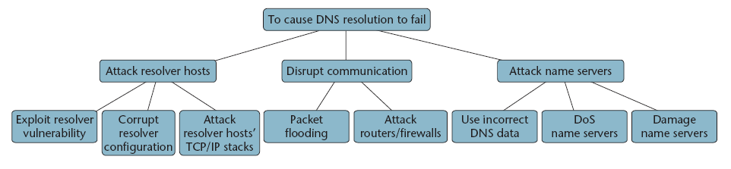
Attack tree: DoS against DNS
Source: Cheung (2006)

Slide 37
How to protect DNS from (D)DoS ?
Multiple scattered name servers
Anycast routing
  Mulitple name servers sharing common IP address
Over-provisioning of host resources and network capacity
Use of dedicated machines

Slide 38
Contents
Introduction
Classical DoS attacks
Flooding attacks
Distributed Denial-of-Service (DDoS)
Reflector and amplifier attacks
Other DoS attacks
Approaches to defense against DoS

Slide 39
Defenses against DoS attacks
Limit ability of systems to send spoofed packets
  Filtering done as close to source as possible by routers/gateways
  Reverse-path filtering ensure that the path back to claimed source is same as the current packet’s path
    Ex: On Cisco router “ip verify unicast reverse-path” command
Rate controls in upstream distribution nets
  On specific packet types
  Ex: Some ICMP, some UDP, TCP/SYN
Use modified TCP connection handling
  Use SYN-ACK cookies when table full
  Or selective or random drop when table full

Slide 40
Defenses against DoS attacks
Block IP broadcasts
Block suspicious services & combinations
Manage application attacks with “puzzles” to distinguish legitimate human requests
Use mirrored and replicated servers when high performance and reliability required

Slide 41

October 2009
6th Annual National Cybersecurity Awareness Month
One of the themes: shared responsibility

Slide 42
Tools to Help Detect DDoS Tools
Zombie Zapper – puts Trinoo, TFN, Stacheldraht, and Shaft zombies “to sleep” when flooding http://razor.bindview.com
Remote Intrusion Detector (RID) : Locates Trinoo, Stacheldraht, TFN on network http://www.theorygroup.com/Software/RID/

